Slide 1
Intro to Alchemy: Convert Existing Workloads to Gold-Master Images
HO126888
Wayne Patton – SUSE – Technical Account Manager Rick Ashford – SUSE – Sales Engineering Manager

Slide 2

Agenda Hands On
Inspect System with Machinery
Overview of Machinery Data
Machinery export to html
Machinery Export to KIWI
Build new image with KIWI
Run image
Modify image data
Rebuild with KIWI
Run image
Sandbox time
What is Machinery?
What is KIWI?
What problem is solved?
Common Use Case(s)

Slide 3
Converting Workloads
Move a system from platform to platform (physical or virtual)
Move a system to the cloud
Define a base system that’s repeatable

Slide 4
Converting Workloads
Move a system from platform to platform (physical or virtual)
Move a system to the cloud
Define a base system that’s repeatable
Machinery – Will inspect a system creating a system description
KIWI – Tool used to build a system image

Slide 5
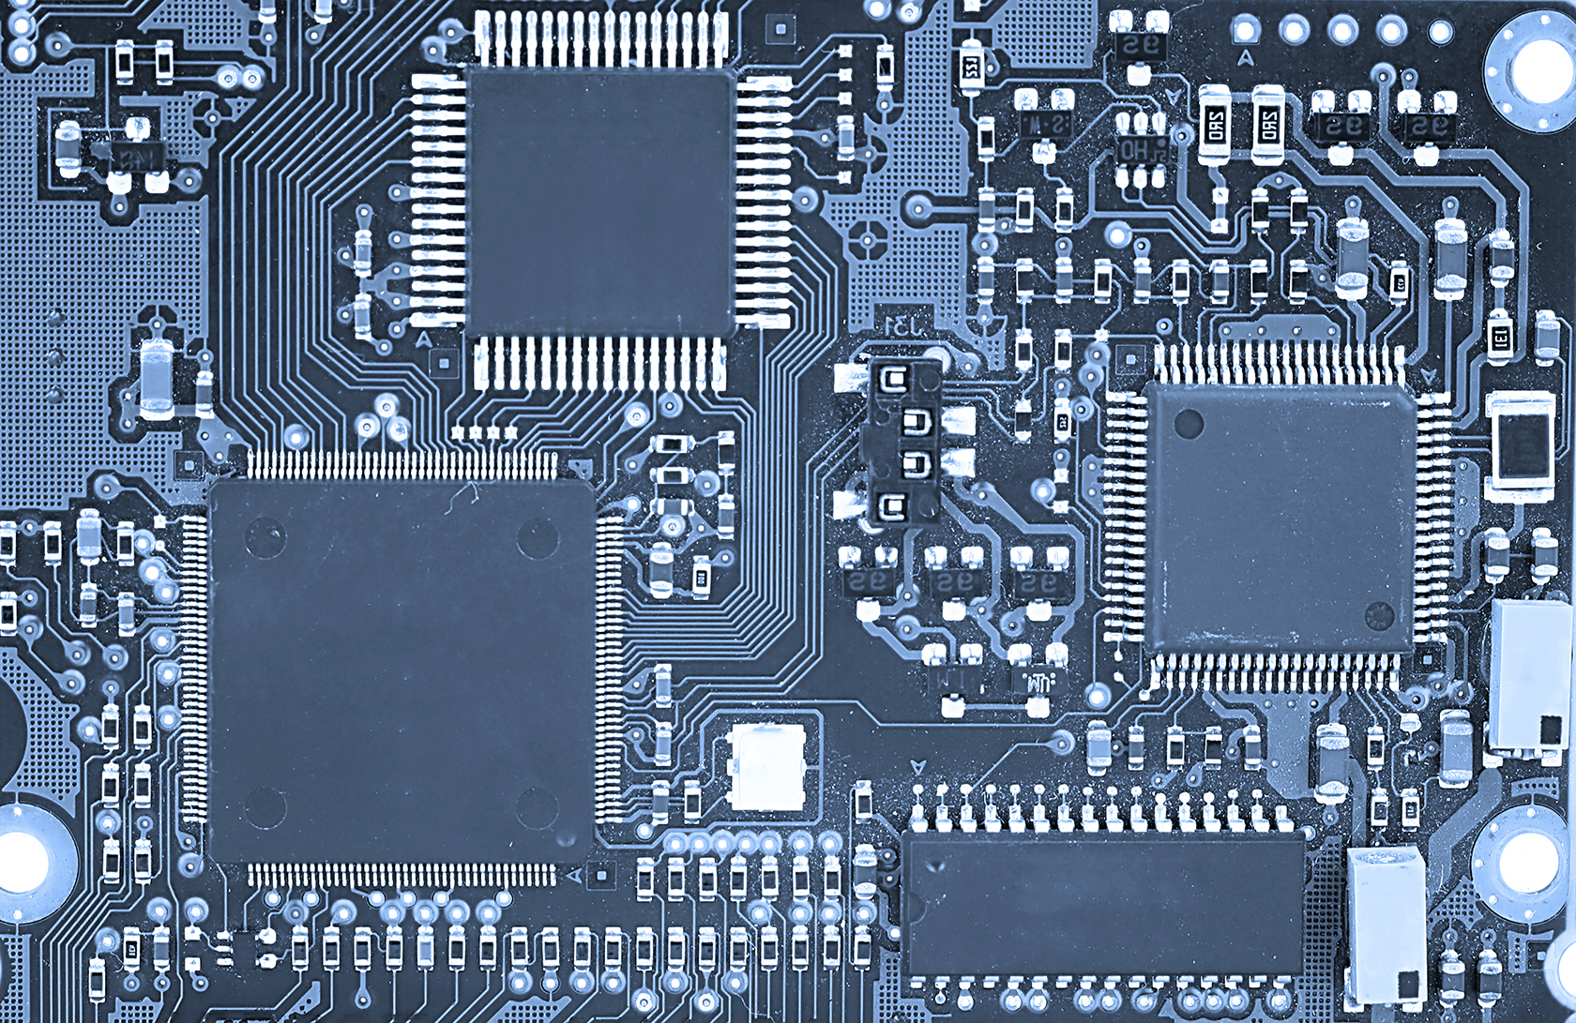
What is Machinery?
http://machinery-project.org/
A command line application for creating and working with system descriptions

Slide 6
What is Machinery?
http://machinery-project.org/
A command line application for creating and working with system descriptions
Discover configuration
Inspect a system
Extract configuration information into various output formats

Slide 7
What is Machinery?
http://machinery-project.org/
A command line application for creating and working with system descriptions
Discover configuration
Inspect a system
Extract configuration information into various output formats
Validate Systems
Compare against known good state
Track changes over time

Slide 8
What is Machinery?
http://machinery-project.org/
A command line application for creating and working with system descriptions
Discover configuration
Inspect a system
Extract configuration information into various output formats
Validate Systems
Compare against known good state
Track changes over time
Uses ssh key for accessing inspected systems

Slide 9
Machinery Use Case
Creating system description
Export inspection data (ie: KIWI or HTML)
Compare system descriptions
Same system different time
Different systems
Example – Several web servers are supposed to be the same but one isn’t acting correctly
Physical to Cloud
Migrate SLE 11 to SLE 12

Slide 10
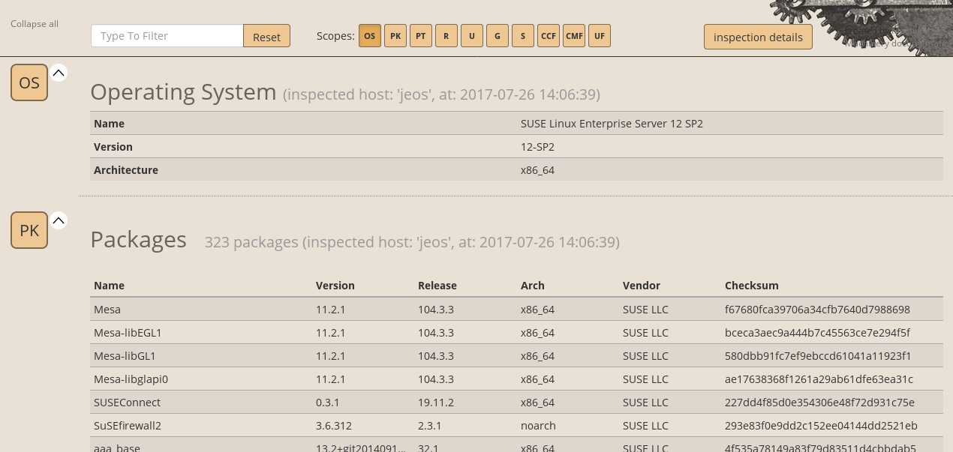
Machinery html output example

Slide 11
Machinery compare example
srv:~ # machinery inspect jeos
srv:~ # machinery copy jeos jeos.orig
Install apache on jeos
Create index.html on jeos
srv:~ # machinery inspect jeos
srv:~ # machinery compare jeos.orig jeos
# Packages
Only in 'jeos':
* apache2, * apache2-prefork
* apache2-utils, * libapr-util1
* libapr1, * liblua5_2
* libnghttp2-14
# Services
Only in 'jeos':
* apache2.service: disabled
* apache2@.service: disabled
# Unmanaged Files
Only in 'jeos':
* /etc/sysconfig/apache2 (file)
* /srv/www/htdocs/index.html (file)
* /usr/sbin/httpd (link)
* /var/lib/systemd/migrated/apache2 (file)

Slide 12

What is KIWI?
Tool for building Linux system images
SUSE Studio uses it as back-end
openSUSE Build Service
SUSE Products are built with KIWI
Included and fully supported in SUSE Enterprise Linux. (SLES)

Slide 13
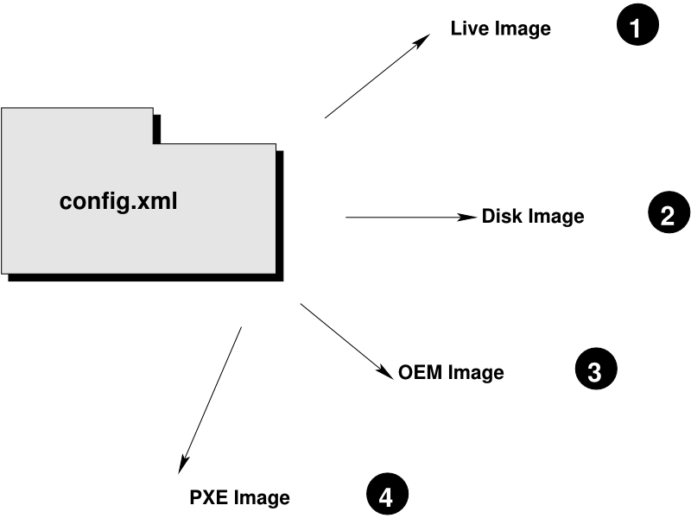
What is KIWI?
Tool for building Linux system images
SUSE Studio uses it as back-end
openSUSE Build Service
SUSE Products are built with KIWI
Included and fully supported in SUSE Enterprise Linux. (SLES)
Output many formats:

Slide 14
What is KIWI?
Tool for building Linux system images
SUSE Studio uses it as back-end
openSUSE Build Service
SUSE Products are built with KIWI
Included and fully supported in SUSE Enterprise Linux. (SLES)
Output many formats:
ISO Live CD/DVD
PXEBoot Hard Disk
USB Amazon EC2 (.ami)
Docker Google Cloud Format (..gce)
VMware (.vmdk) XEN
Vagrant (.vagrant)
VirtualBox (.vdi)
Virtual Hard Disk (.vhd)
KVM/Qemu (.qcow2)
Open Virtualization Format (.ovf, .ova)

Slide 15
KIWI Process
KIWI process is divided into two stages
Preparation:
Create a root file system defined by configuration file.
Installs packages into the filesystem
Results in unpacked root tree

Slide 16
KIWI Process
KIWI process is divided into two stages
Preparation:
Create a root file system defined by configuration file.
Installs packages into the filesystem
Results in unpacked root tree
Creation:
desired image is created from the directory structure
https://doc.opensuse.org/projects/kiwi/doc/

Slide 17

Lab Environment
Two Virtual Machines
sca – “Admin” machine you will do all work from. Login as Geeko/linux
sc1 – This is the system we are going to inspect with Machinery

Slide 18
Lab – What are we going to do?
Use machinery to inspect a VM.
Explore the Universal System Description
Export the description to KIWI
Use KIWI to replicate original system and run a new VM
Modify KIWI configuration, re-build and run
Use machinery to compare configurations

Slide 19
Lab
Open Intro-to-Alchemy-LAB.pdf
Text with grey background represents commands to type
You will be logged in as root!
Passwords = “linux”

Slide 20
Questions ??

Slide 22
Unpublished Work of SUSE LLC. All Rights Reserved.
This work is an unpublished work and contains confidential, proprietary and trade secret information of SUSE LLC. Access to this work is restricted to SUSE employees who have a need to know to perform tasks within the scope of their assignments. No part of this work may be practiced, performed, copied, distributed, revised, modified, translated, abridged, condensed, expanded, collected, or adapted without the prior written consent of SUSE. Any use or exploitation of this work without authorization could subject the perpetrator to criminal and civil liability.
General Disclaimer
This document is not to be construed as a promise by any participating company to develop, deliver, or market a product. It is not a commitment to deliver any material, code, or functionality, and should not be relied upon in making purchasing decisions. SUSE makes no representations or warranties with respect to the contents of this document, and specifically disclaims any express or implied warranties of merchantability or fitness for any particular purpose. The development, release, and timing of features or functionality described for SUSE products remains at the sole discretion of SUSE. Further, SUSE reserves the right to revise this document and to make changes to its content, at any time, without obligation to notify any person or entity of such revisions or changes. All SUSE marks referenced in this presentation are trademarks or registered trademarks of Novell, Inc. in the United States and other countries. All third-party trademarks are the property of their respective owners.

